Slide 1


Games street
A presentation on Project
Session (2022-2023)
Hemvati Nandan Bahuguna Garhwal University
School of Engineering and Technology
Department of Information Technology
Guide: Submitted by:
Dr. Varun Barthwal Shivang Goyal
Pattupogula Sravani
Suraksha Dhanai

Slide 2
Project will have 2 phases and the team division is as follows:
More explaination:
The game will be divided into three categories :
2d- emulator based
2d- without emulator
3d- designed world
The games are to be developed using game engines like:
GODOT
GB STUDIOS
GAMEDEVELOPER3
Phase I:
In this phase the product (game ) is being prepared by different means.
Phase II:
In this phase the website with all the game is ready to get access and with backend
To get users satisfaction.
Team division:
Shivang Goyal : game development ,design & backend (L)
P.Sravani : Full stack web development for website
Suraksha Dhanai : Testing & documentation of project

Slide 3
Table of contents to be shown:
Topic 1 | Introduction of the project
Topic 2 | Work functions and game logic
Topic 3 | Logic development and user interface demonstration
Topic 4 | Website development and platform for gameplay
This project may or may not interest you for further development but it will be helpful in preparing you for what is to come in the future and how we can learn an language easily and use it in ways that will prove to be entertaining.

Slide 4
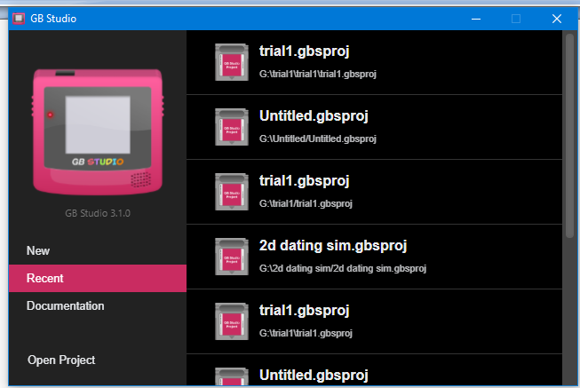
Introduction
Background and objective:
one man project with a point of view to provide user with interaction and knowledge, and will be able to provide the users proper guidance.
If user learns the use of game engine they can develop the game further.
For children and for elderly people too.
provide people with knowledge on basic level along with entertainment.
Purpose for the creation of this project:
The idea is to make learning easy for kids while playing games and using different interfaces.
It will increase the curiosity of kids to learn coding and develop their own games.
Gameboy Studios

Slide 5
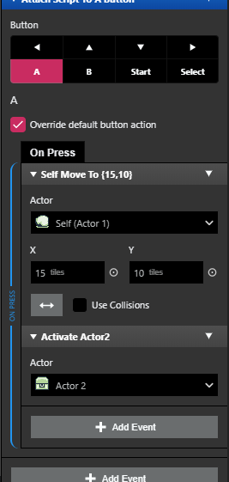
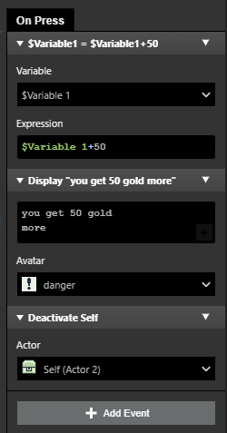
Work functions
This style of gaming is called as retro gaming and many people have played these epic games.
The file base is based on c and s languages.
It uses script based interface which allows the user to make particular script for a particular purpose.
The game is going to be built by using some inbuilt functions interfaces and putting our own loops, variable use, scripts and developed assets.
The emulator looks like this:

Slide 6
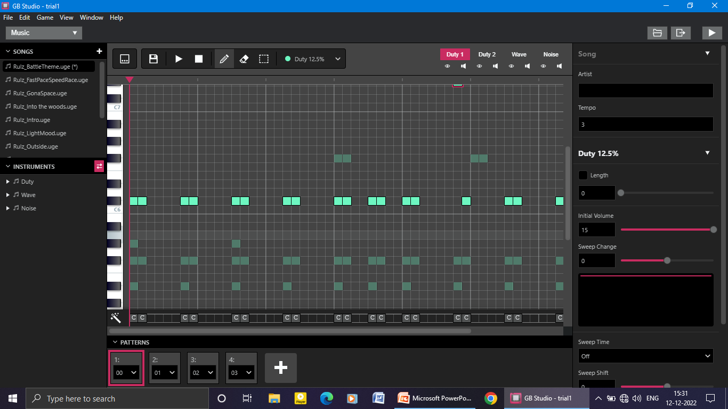
The music is developed here:

Slide 7
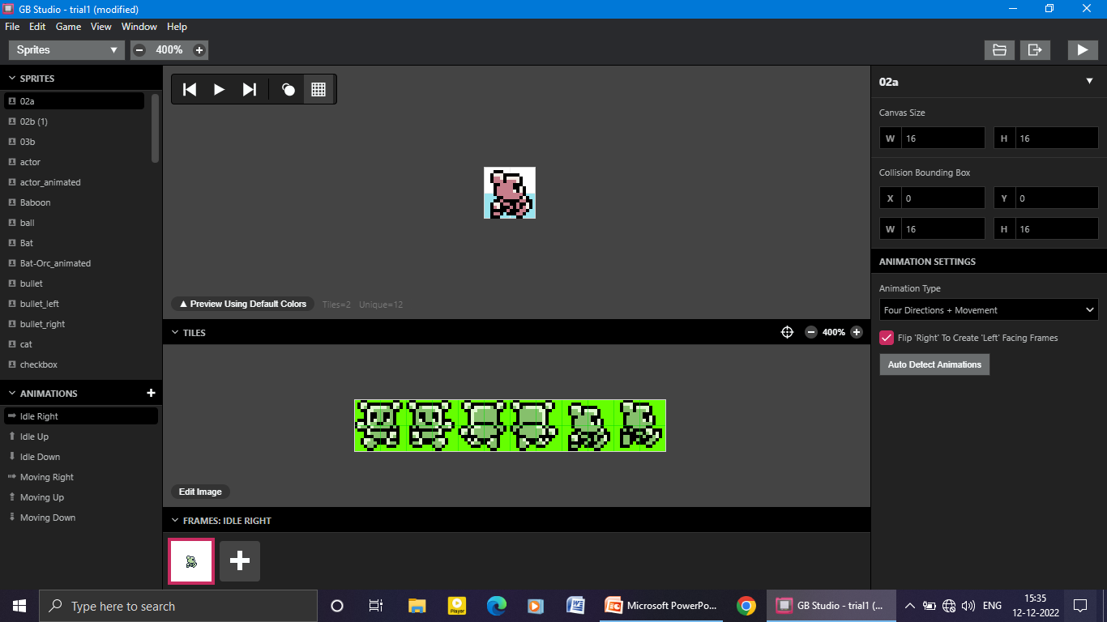
The character animation is designed here:

Slide 8
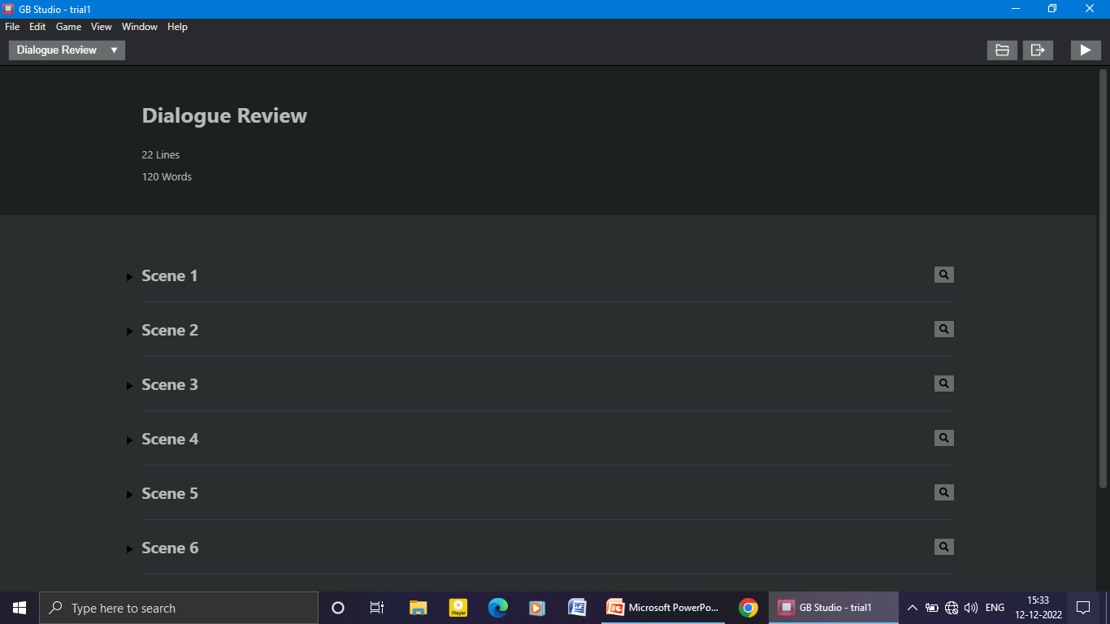
We can review the dialogues in each scene:

Slide 9
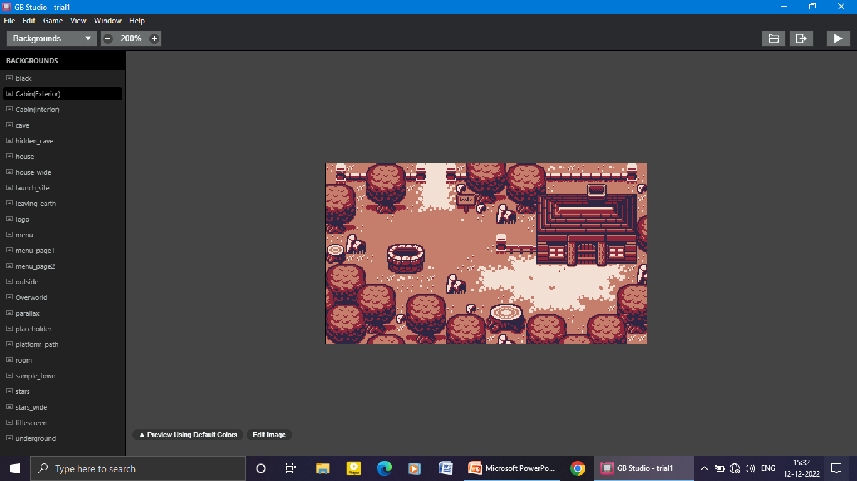
Background are designed and put to use from here:

Slide 10
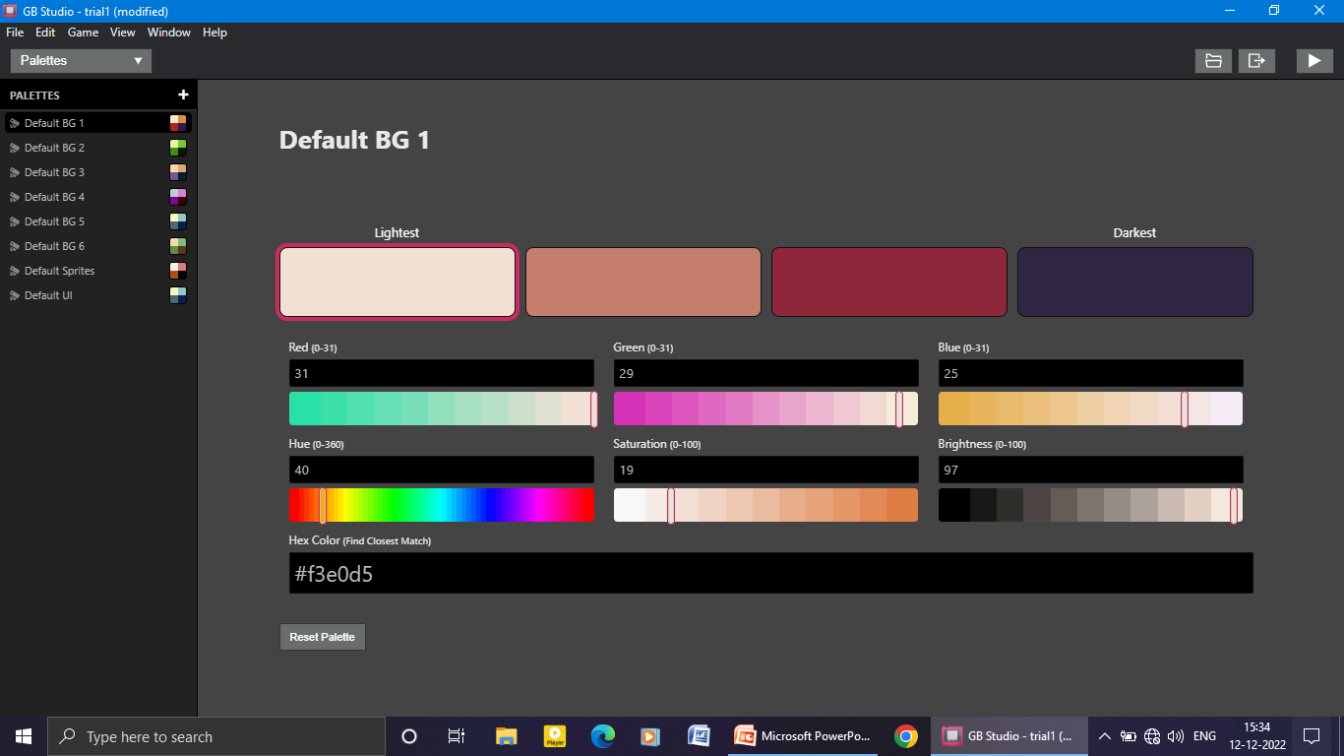
Different colour in the game are put from here:

Slide 11
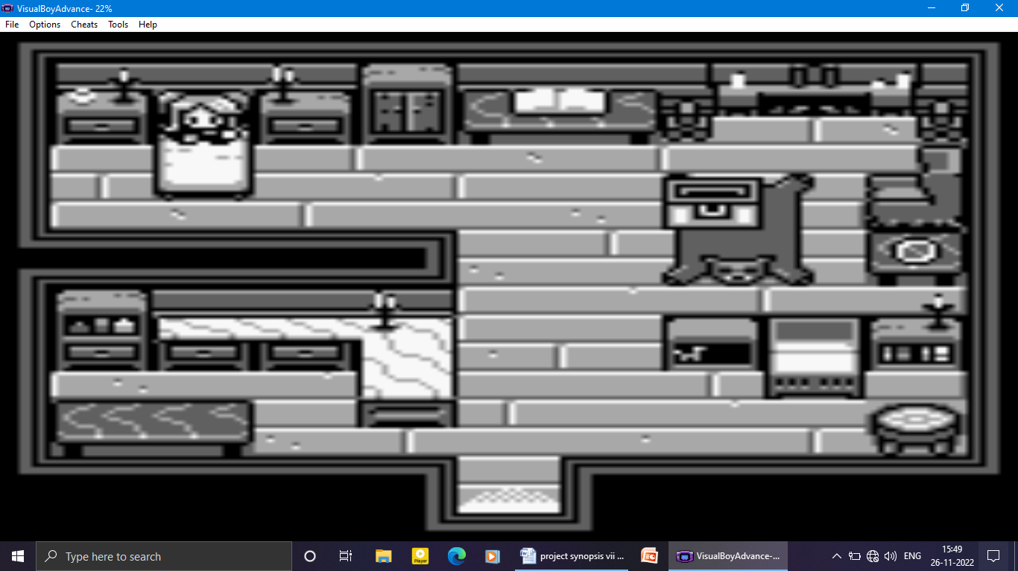
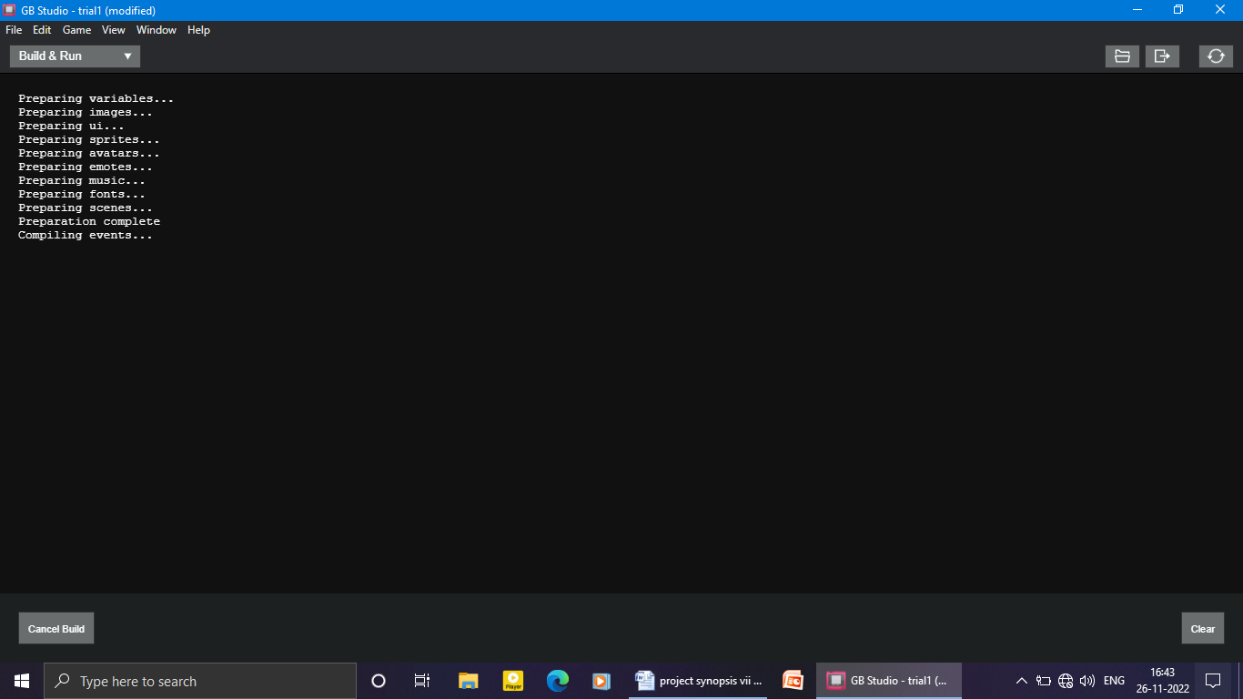
Logic development and user interface demonstration
The game has a user friendly interface
This is the beginning of the game first scene.
The logic will use character attributes and the assets of the game that are provided, the game is playable only after being built which will compile the game done under the developers.

Slide 12
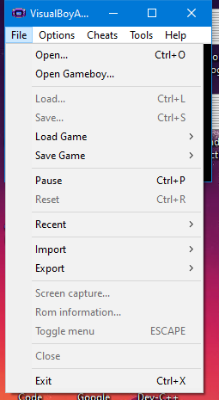
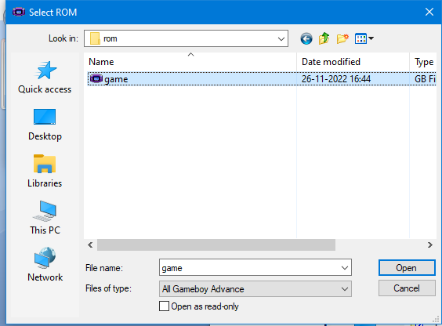
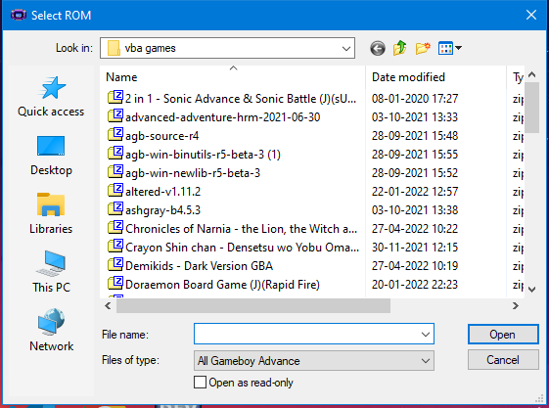
The game will be in a game.gb file.
If the user is on a UNIX shell or Linux shell system then they can use the file location in path without any problem and can access the game file through gcc compiler rather then the emulator.
We own the sellable rights for each games we develop by the developer team of Gb studios through github.

Slide 13
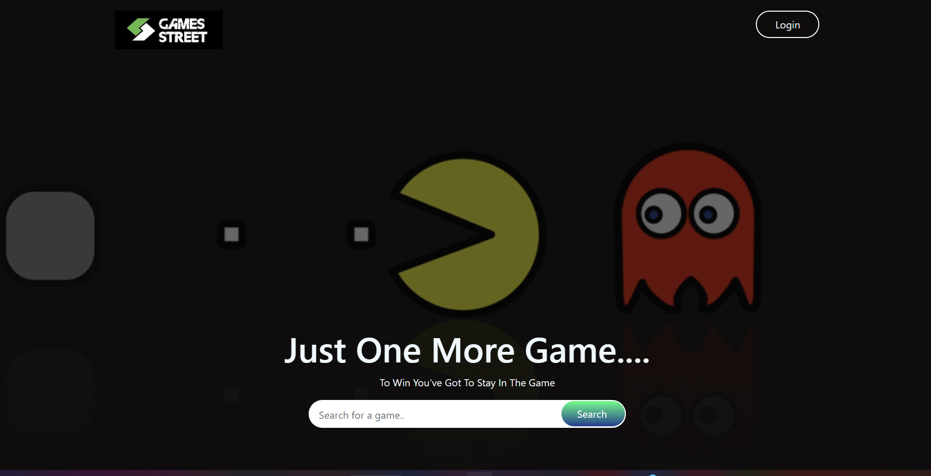
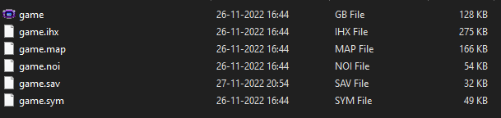
Website development and Platform for Gameplay
We have started working on the website on which we will deploy different types of games.
The website is the 2nd phase of this project with which we will do different tasks and will demonstrate with security a game download and a gameplay where we will let the user play the game on the website itself.

Slide 14
Future scope
This project has a wide range of games, and is a start up idea that might be possible to work with in order to form a company and get earning easily done.
After its full development and launch we will be able to make the game playable on web with advertisements.
People can play the game while the ads will be playing on their own on the website further from the gameplay so as to make it preferable to users needs and full of enjoyment.
User
Login id
Game number
Browser
Game
Browser
number

Slide 15
conclusion
This project is based on 2 parts and the first is hereby concluded the next part is almost too challenging but we will do our best in order to host the game on the web server on local host and will ensure the testing of each of our product.
The game products of our team are fully free of copyrights and is fully functional for all purpose development and to sell the game on online platform that are available.
We hereby would like to thank Varun Barthwal sir for helping us as our instructor throughout the whole game development.

Slide 16
Thank You!

